Slide 1

CROP PREDICTION SYSTEM
Aditi Jain
Akshay Singh
Vaibhav Chauhan

Slide 2
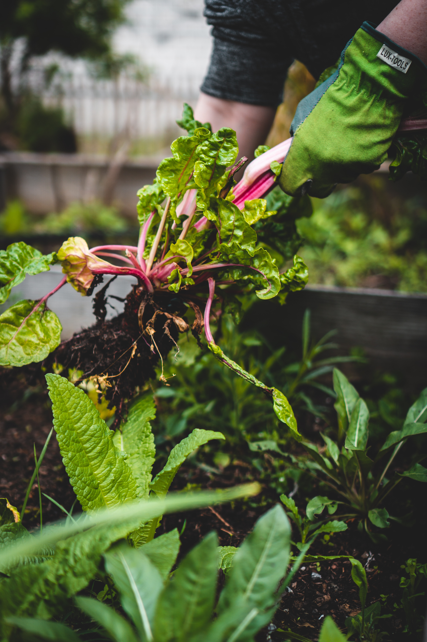

OBJECTIVE
The primary objective of this project is to develop a robust and accurate crop prediction system using machine learning techniques. The system will utilize various environmental factors such as soil pH, soil moisture, NPK (Nitrogen, Phosphorus, Potassium) content, and expected rainfall to predict the most suitable crop for a given region. This system aims to assist farmers in making informed decisions about crop selection, optimizing resource utilization, and improving agricultural yield.

Slide 3

SCOPE
Collect and integrate data on soil characteristics (pH, moisture, NPK content) from various sources.
Gather historical rainfall data for the target region.
Develop and train machine learning models to predict the best-suited crop for a given set of environmental conditions.
Implement a user-friendly interface for farmers to input their location and obtain crop recommendations.
Provide detailed information about the recommended crop, including planting guidelines.
Generate reports and insights to aid decision-making in agriculture.
The system will consider a wide range of crops suitable for the region, taking into account seasonal variations.

Slide 4

NOVELTY
The novelty of this project lies in its comprehensive approach to crop prediction. By incorporating multiple environmental factors, historical data, and machine learning algorithms, it goes beyond simple rule-based systems and offers accurate and adaptable recommendations. Additionally, the project's user interface and reporting features make it highly accessible and practical for farmers.

Slide 5

LITERARY REVIEW
The project builds upon existing research in the field of agricultural decision support systems and crop prediction using machine learning. Relevant literature includes studies on:
Crop Yield Prediction: Various studies have focused on using machine learning techniques to predict crop yields based on environmental factors.
Soil Analysis: Research on soil analysis and its impact on crop selection is critical to understanding the relationship between soil characteristics (pH, moisture, NPK content) and crop performance.
Rainfall Prediction: Historical rainfall data and its significance in crop planning have been explored in agriculture research.
User Interface Design: Usability studies and user interface design principles are relevant to create an intuitive system for farmers.

Slide 6
PROPOSED METHODOLOGY
Data Collection: Gather data on soil pH, soil moisture, NPK content, and historical rainfall data from various sources and regions.
Data Preprocessing: Clean and preprocess the data, handling missing values, and standardizing data formats.
Feature Engineering: Create relevant features that represent the environmental conditions accurately.
Machine Learning Model Selection: Experiment with different machine learning algorithms such as decision trees, random forests, and neural networks to determine the best model for crop prediction.
Model Training: Train the selected model using historical data.
User Interface Development: Create a user-friendly web or mobile interface where users can input their location and receive crop recommendations.
Integration: Integrate the trained model with the user interface, enabling real-time predictions.
Reporting and Insights: Develop a reporting module that provides detailed information on the recommended crop offers insights into the decision-making process.
Testing and Validation: Test the system with real-world data and validate its accuracy against known outcomes.
Deployment: Deploy the system for use by farmers in the target regions.

Slide 7
HARDWARE AND SOFTWARE REQUIREMENTS
HARDWARE
software
Server or cloud-based infrastructure for hosting the system.
Database server for storing and managing data.
Programming languages (Python, JavaScript).
Machine learning libraries (scikit-learn, TensorFlow, or PyTorch).
Web development frameworks (Django, Flask, React, or Angular).
Database management system (MySQL, PostgreSQL, or MongoDB).
Geographic Information System (GIS) tools for location-based data.
Data visualization tools (Matplotlib, D3.js).
Web hosting and domain for deployment.

Slide 8
MODULE DESCRIPTION
Data Collection Module: This module collects data from various sources, including soil sensors, weather stations, and historical databases.
Data Preprocessing Module: It handles data cleaning, transformation, and integration to prepare the data for analysis.
Machine Learning Module: This module includes model training, validation, and testing using environmental data and crop yield information.
User Interface Module: A user-friendly interface where farmers can input their location and receive crop recommendations.
Reporting and Insights Module: Generates detailed reports on recommended crops, planting guidelines, and historical data analysis.

Slide 9
FUNCTIONALITIES
Input Data: Users can input their location or select it on a map to obtain crop recommendations.
Crop Prediction: The system predicts the most suitable crop based on environmental factors.
Planting Guidelines: Users receive guidelines on planting, fertilization, and irrigation for the recommended crop.
Historical Data Analysis: Farmers can access historical data and insights to make informed decisions.

Slide 10
TIMELINE
Project Planning and Research
Data Collection and Pre-processing
Machine Learning Model Development
User Interface Design and Development
Deployment and Testing

Slide 11

EXPECTED OUTCOME
Accurate Crop Predictions: A system that provides accurate crop recommendations based on soil conditions, NPK content, and rainfall data.
Increased Agricultural Productivity: Farmers will be able to make informed decisions, potentially leading to increased crop yields.
User-Friendly Interface: An intuitive interface accessible to farmers with minimal technical knowledge.
Data Insights: Detailed reports and historical data analysis to aid decision-making.
Contribution to Agriculture: A valuable tool for sustainable and optimized agriculture practices.

Slide 12


References (IEEE Format)
[1] Smith, J., et al. (2019). Machine Learning Approaches for Crop Yield Prediction: An Overview. IEEE Transactions on Agriculture and Environment, 20(3), 456-465.
[2] Wang, Q., et al. (2018). Soil Analysis and Its Role in Crop Selection: A Review. IEEE Journal of Soil Science, 15(2), 210-223.
[3] Rainfall Prediction Models: A Comparative Study. (2017). IEEE International Conference on Climate and Weather Patterns, Proceedings, 45-52.
[4] Nielsen, M. (2012). Usability Engineering. IEEE Computer Society Press.
[5] Patel, R., et al. (2020). User-Centred Design Principles for Agricultural Decision Support Systems. IEEE Transactions on Human-Computer Interaction, 25(4), 315-328.

Slide 13
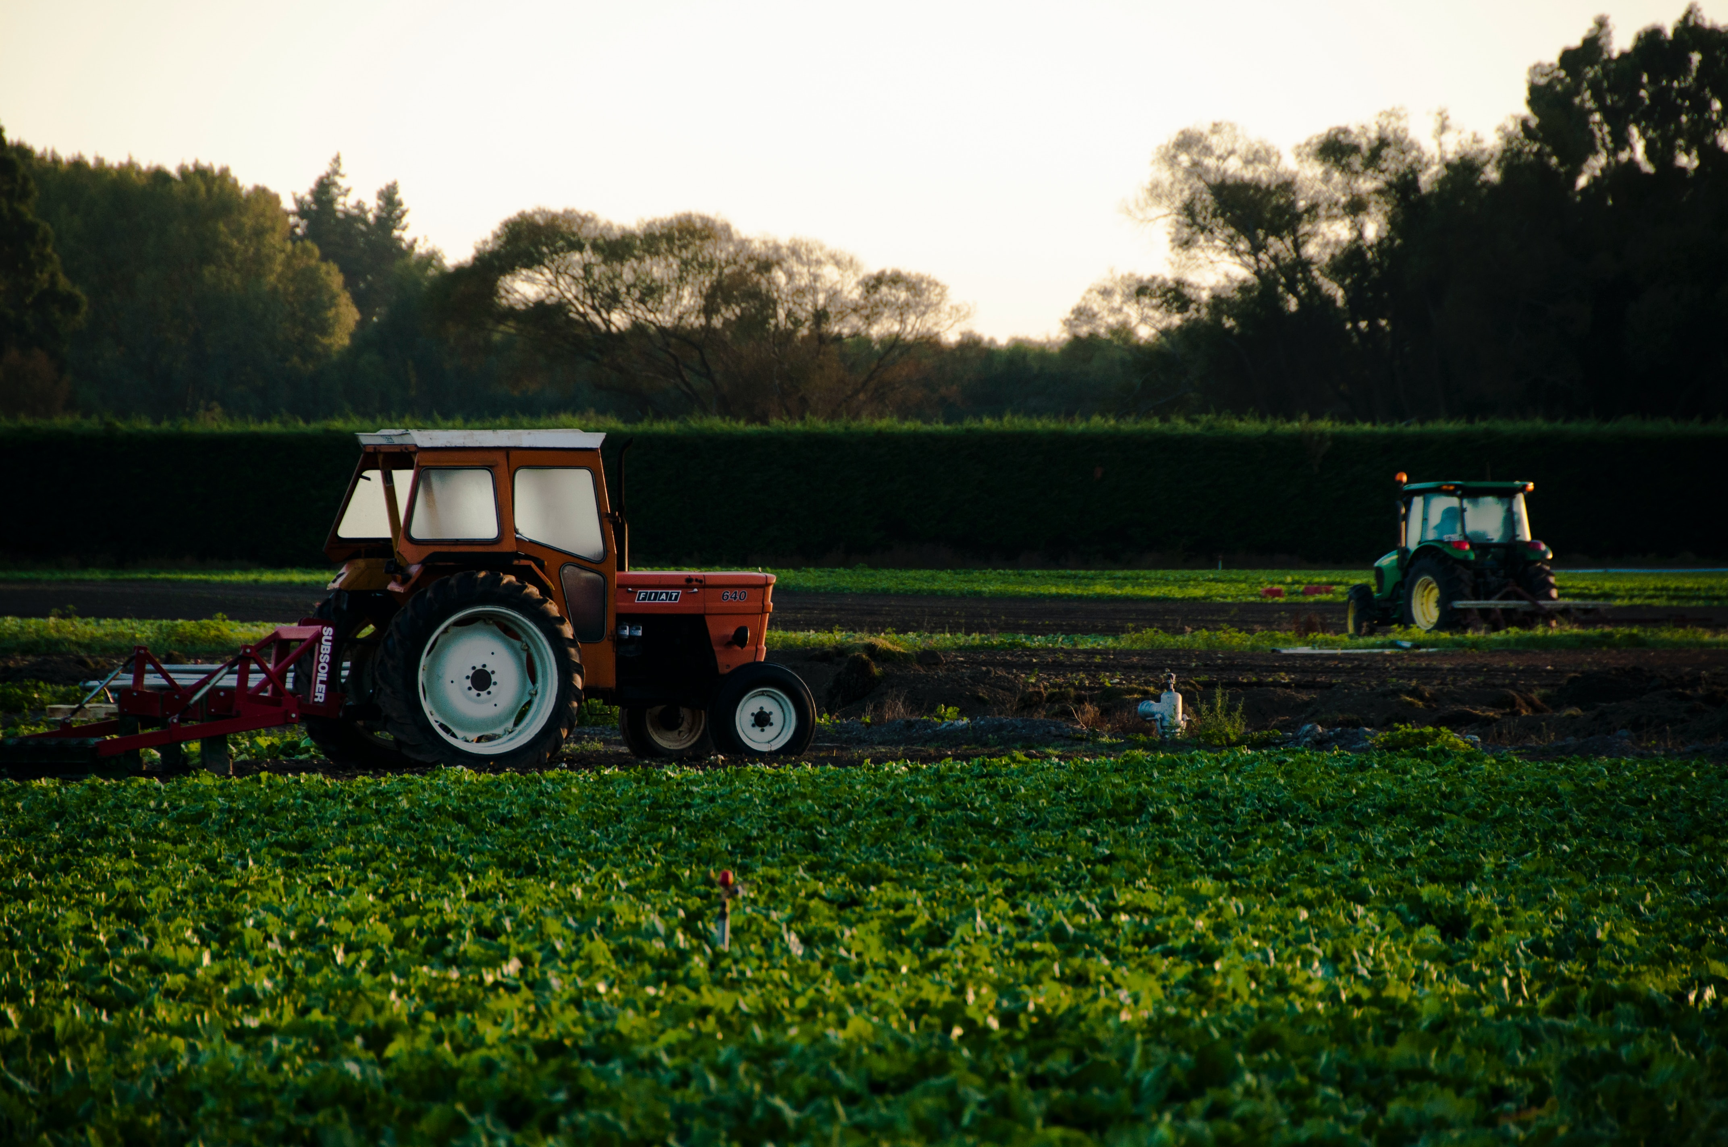
Thank you

